Slide 1
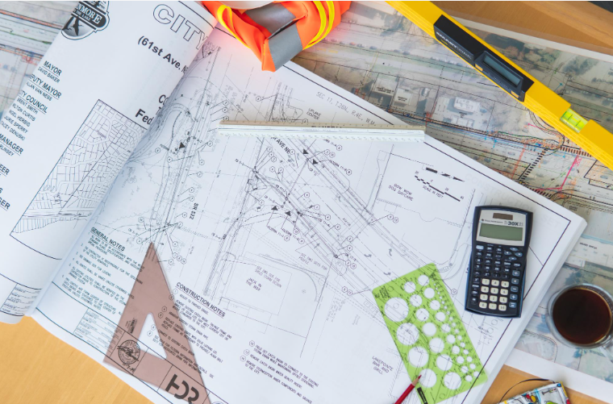
Engineering Purpose/Scope
Ensure Safe and Efficient Operation of the Right of Way
Road Standards
Traffic Data Collection and Analysis
Right of Way Permitting
Title 10 and 12 KMC

Slide 2
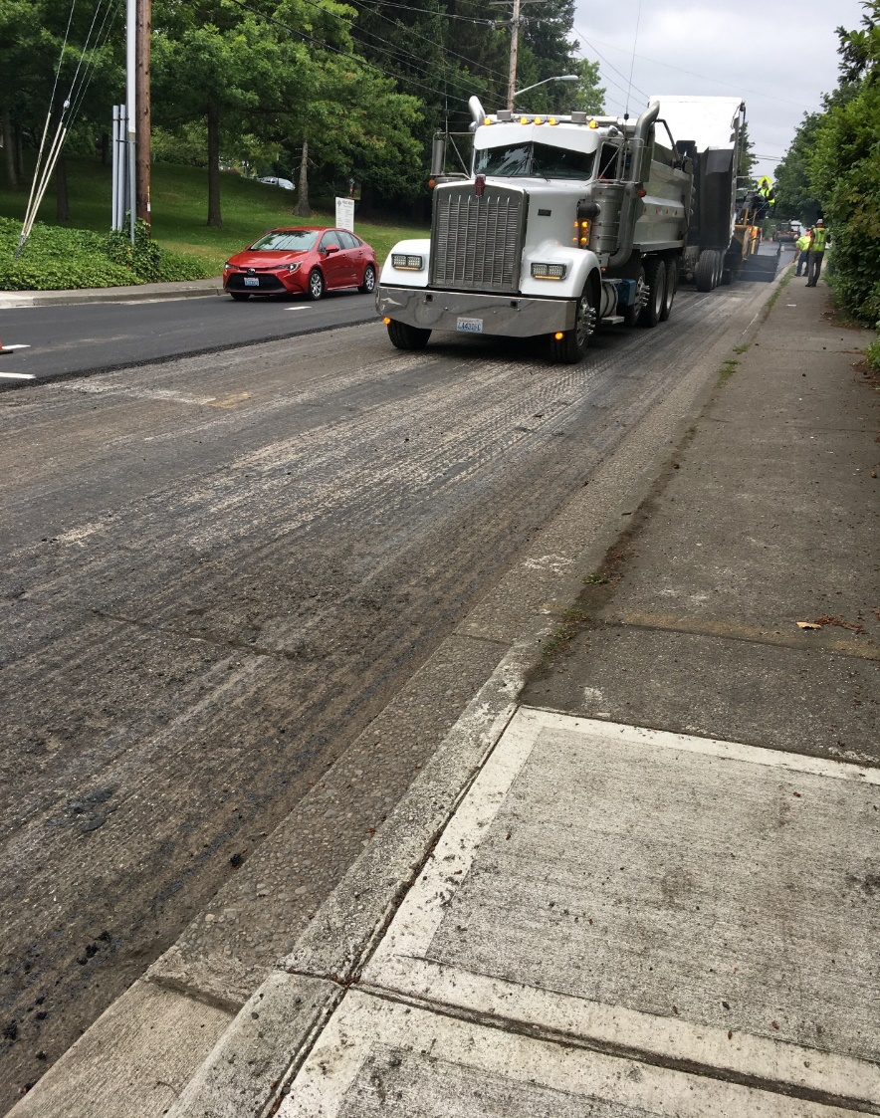
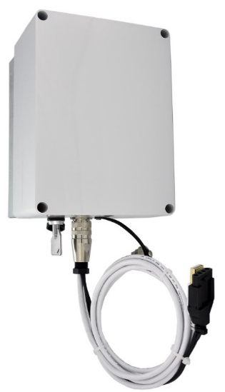
Engineering Core Responsibilities
Transportation Capital Improvement Program (CIP)
Pavement Management
Traffic Engineering
Utility Permitting
Right Of Way Management
Code and standards
Code enforcement
Transportation Planning
Pedestrian/Bicycle Accessibility
Long/short range planning

Slide 3
Engineering Team Structure
Engineering Director
Senior Civil Engineer
Senior Civil Engineer
Capital Projects Manager
City Traffic Engineer
Right of Way Inspector
Administrative Specialist
Transportation Capital Improvement Program (CIP)
Pavement Management
Traffic Engineering
Utility Permitting
Right Of Way Management
Transportation Planning

Slide 4
Engineering Department Expenses
Capital Projects (CIP)
Utility Permitting
Pavement Management
Traffic Safety
Right of Way Management
Transportation Planning
General Engineering Expenses

Slide 5
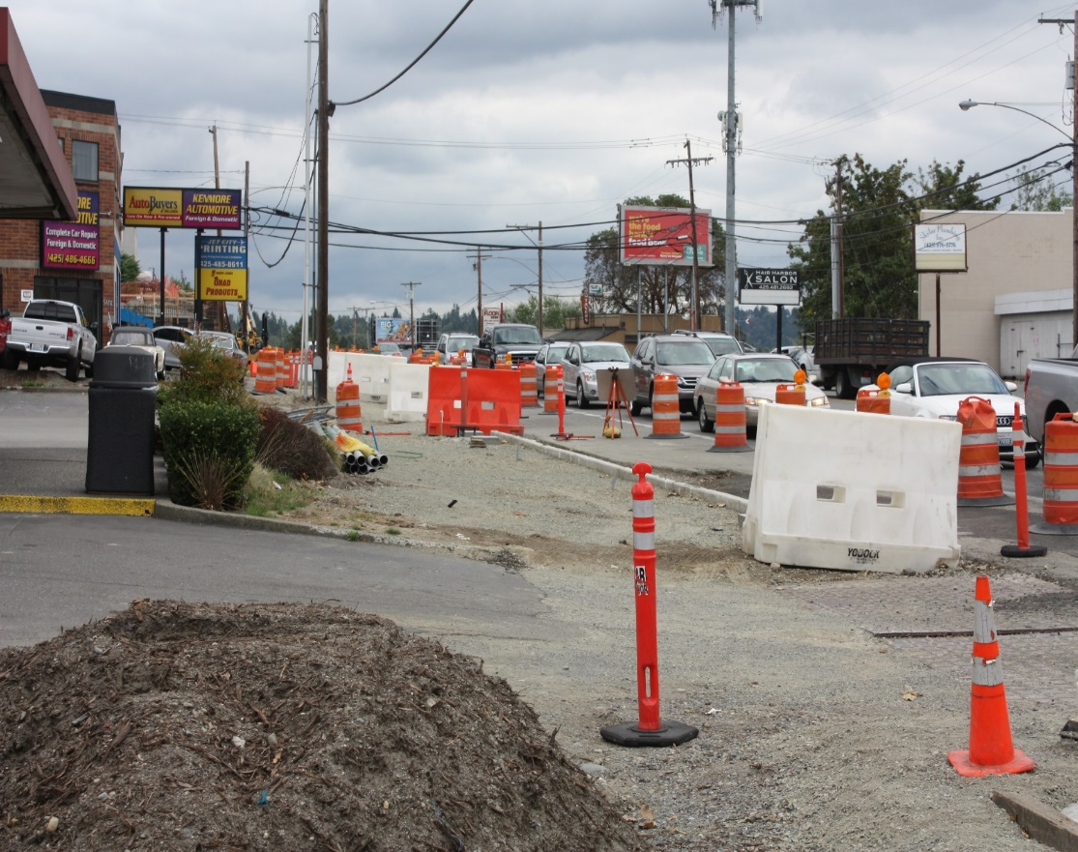
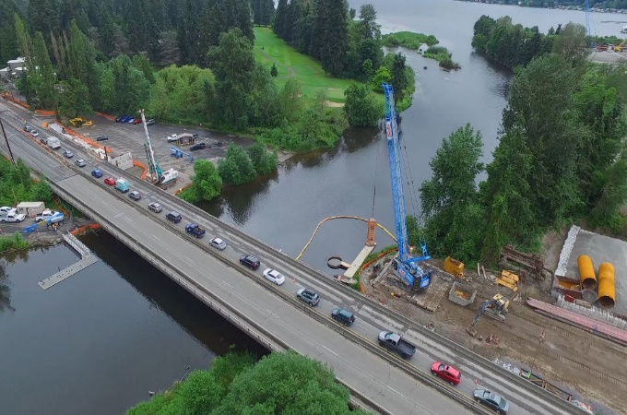
Engineering Department Expense/Revenue
Capital Projects (CIP)
Expenses (~$410K/year – staff only)
Project Managers (x2): 75% of time ~$275K/year (incl. benefits
Project Manager: 30% of time $57K/year (incl benefits)
Engineering Director: 30% of time ~$68K/year (incl. benefits)
Administrative Assistant: 10% of time ~$10K
Capital Projects: Variable cost
Revenue Sources
Real Estate Excise Tax (REET)
Transportation Impact Fees
Grants
2021 - $1,364,265
2022 - $9,801,991
2023 - $4,727,000

Slide 6
Engineering Department Expense/Revenue
Utility Permitting
Expenses (~$147/year):
ROW Inspector: 55% of time ~$89K/yr (incl benefits)
Administrative Assistant: 40% of time ~$40K (incl benefits)
Engineering Director: 7% of time ~$15K/year (incl benefits)
Software: $3K/year
Revenue Sources
Permit Fees/Fines Collected
~$151K – 2021
~$180K – 2022
~$185K – 2023

Slide 7
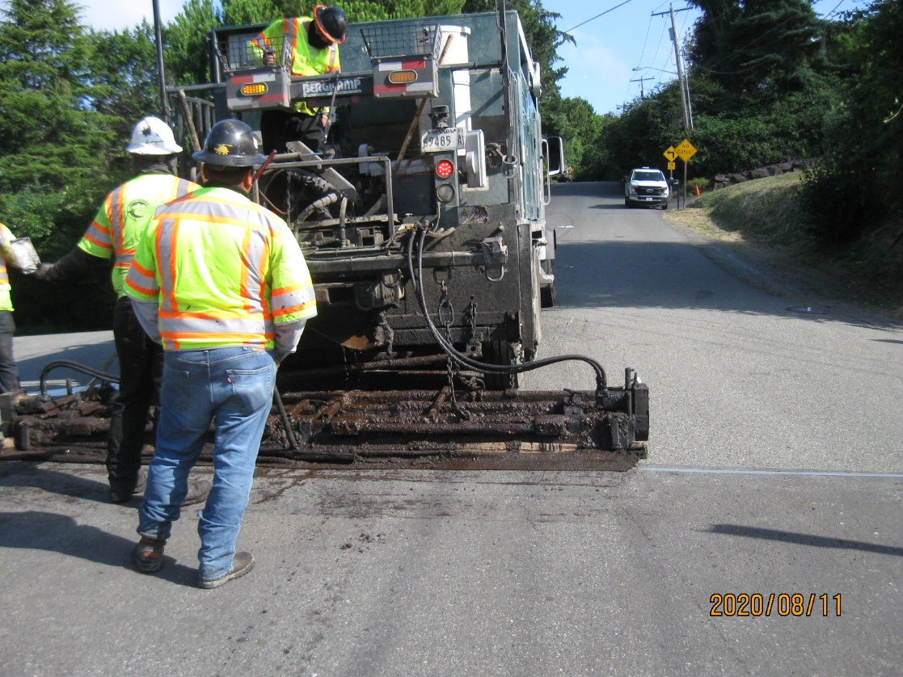
Engineering Department Expense/Revenue
Pavement Management
Expenses (~$1,033K/year)
Project Manager: 40% of time ~$75K/year (incl. benefits)
Engineering Director: 5% of time ~$11K/year (Incl. benefits)
Administrative Assistant: 5% of time ~$5K (incl. benefits)
Software: $5K/year
Pavement Overlay: ~$687/year
Pavement Seals: ~$250K/year
Revenue Sources
REET ($65K staff, $120K overlay, and $3K software)
KAPE ($567K overlay, $2K software)
General Fund ($250K seals and $26K staff)
Grants (none anticipated)

Slide 8
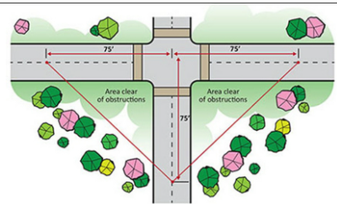
Engineering Department Expense/Revenue
Traffic Safety
Expenses (~263K/year)
Traffic Engineer: 100% of time ~$190K/year (incl. benefits)
Project Manager: 5% of time ~$10K/year (incl. benefits)
Engineering Director: 5% of time ~$11K/year (incl. benefits)
Administrative Assistant: 2% of time ~$2K
Traffic Safety Projects: $50K/year
Revenue Sources
KAPE ($240K)
General fund ($23K)

Slide 9
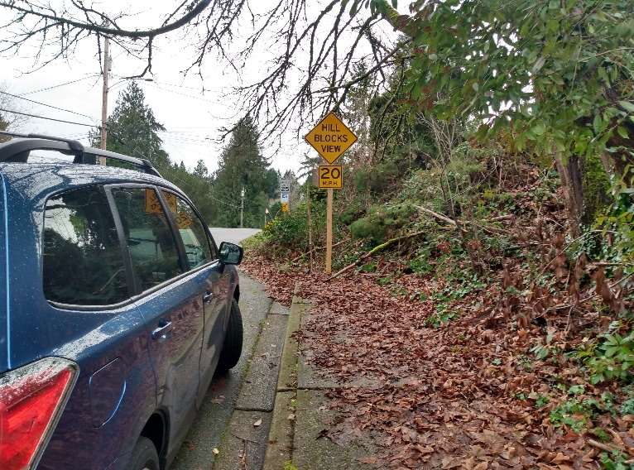
Engineering Department Expense/Revenue
Right of Way Management
Expenses (~82K/year)
Engineering Director: 15% of time ~$34K/year (incl. benefits)
Right of Way Inspector: 20% of time ~$34K/year (incl. benefits)
Administrative Assistant: 13% of time ~$14K/year
Revenue Sources
General fund ($48K)
Street fund ($34K)
Title 10 &12

Slide 10
Engineering Department Expense/Revenue
Transportation Planning
Expenses (~27K/year)
Engineering Director: 10% of time ~$22K/year (incl. benefits)
Administrative Assistant: 5% of time ~$5K/year
Revenue Sources
General fund

Slide 11
Engineering Department Expense/Revenue
General Engineering Expenses
Expenses (~418K/year)
Engineering Director: 28% of time ~$63K/year (incl. benefits)
Project Manager (x3): 25% of time ~$142K/year (incl. benefits)
Right of Way Inspector: 25% of time ~$40K/year (incl. benefits)
Administrative Assistant: 25% of time ~$26K/year (incl. benefits)
Engineering Consultants (non-CIP work): ~75K/year
Office Expenses: ~72K/year
Revenue Sources
General fund ($378K)
Street fund ($40K)

Slide 12
Questions?

