Slide 1
CITY OF KENMORE
Finance Department
Department Overview for FSP Task Force
January 17, 2024

Slide 2
Finance Department Main Functions
Financial and Accounting Services
Budget Prep and Oversight
Financial Reporting and Audit
AP, AR, Payroll, Benefits, Fixed Assets, Cash Receipts, Internal Controls
Treasury, Debt and Investment Management
Human Resources
Post hire, Onboarding, Compensation & Benefits Mgmt, Leave Administration, Dispute Resolution
Risk Management
Information Technology

Slide 3
Finance Department Budget 2023-2024
Two Year EXPENDITURE Budget (amended): $3,141,637
Regular Staff Salaries & Wages: $975,300
Benefits: $335,300
Supplies: $14,834
Services: $1,777,498
$1.1M in insurance premiums (WCIA), $330K in IT services, $100K audit costs
KC Services (Intergovernmental): $18,000
Capital expenses (software, furniture): $20,000

Slide 4
Finance Department Budget 2023-2024
REVENUE
Finance does not have any Grants or Direct revenue sources.
Non-departmental Revenue
Interest Income, 2 year budget: $305,091
Finance manages all investments. Interest income is allocated monthly to all funds with existing fund balance.
Interest Income, actual for 2023: $1.1M

Slide 5
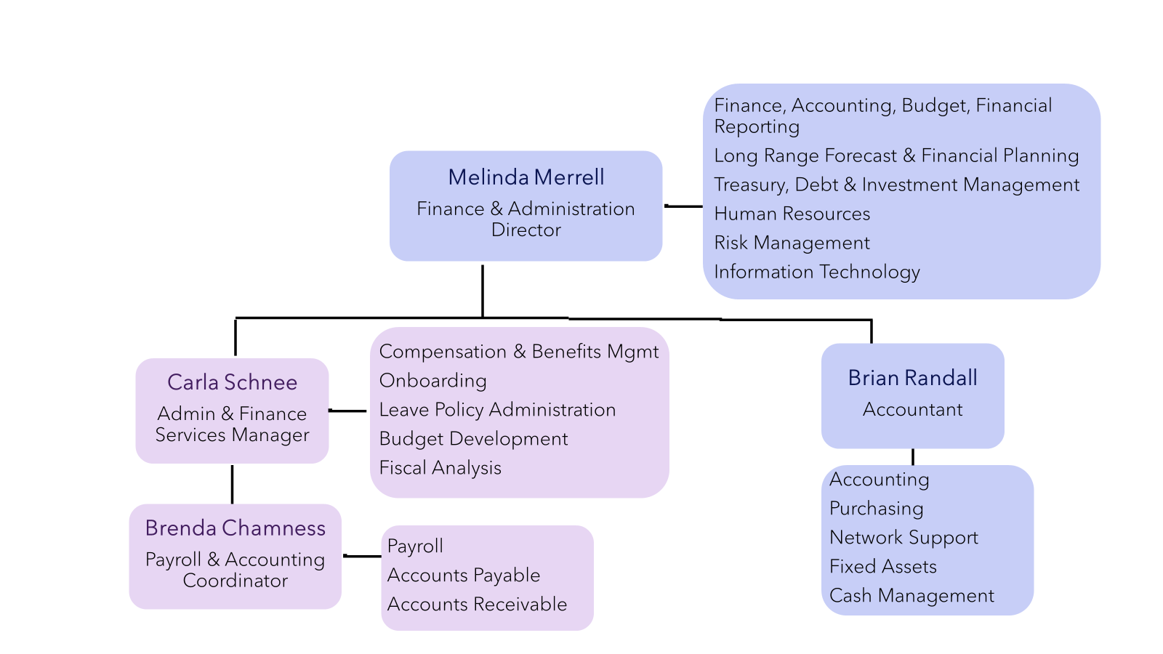
Finance Department Team and Responsibilities

Slide 6
For comments and questions:
Melinda Merrell
Finance & Administration Director
mmerrell@kenmorewa.gov
425-398-8900

