Slide 1
Financial Sustainability Plan Task Force
Finance and Administration
Town Hall – April 3rd

Slide 2
Agenda
Context - review of the city’s financial situation
FSP process to date
Focus on the General and Street Funds
Key expenditure considerations
Key revenue considerations
Review of guiding principles and city priorities
Town Hall objectives and process
Roundtable workshop
Send off and presentation of the Balancing Act tool
Notes:
Slides presented by Edouard

Slide 3
We want to know all your great ideas!
Please write all your ideas, questions, suggestions during the presentation on the Post-It notes at your table.
This will allow us to make sure we can consolidate inputs across groups and get to the exercise part of tonight as quickly as possible!

Slide 4
Why are we here today?
We are here
1% cap on property tax growth
High inflation
Flat growth of other revenues
Unfunded State and Federal mandates*
Other factors (for ex. public safety insurance raise)
* For example, Comprehensive Plan updates are required every 10 years or public records requests where the City cannot recover the full costs of processing by law

Slide 5
What is the FSP task force?
Who
9 Kenmore residents who applied to be part of the task force and were interviewed by City Staff leadership to assess skillsets and personal motivation
What
Provide recommendations to the city manager & finance director on how to improve city finances by $2.6M per year, through either expenditure reductions, revenue opportunities or both
How
Synthesis of:
10 in person meetings with City Staff
Town Hall recommendations
Outputs of BalancingAct tool

Slide 6
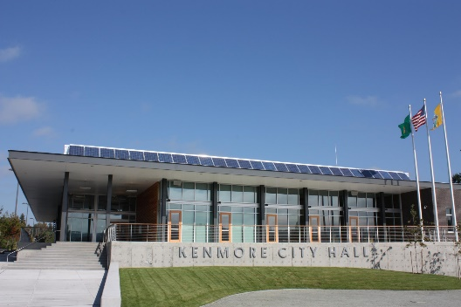
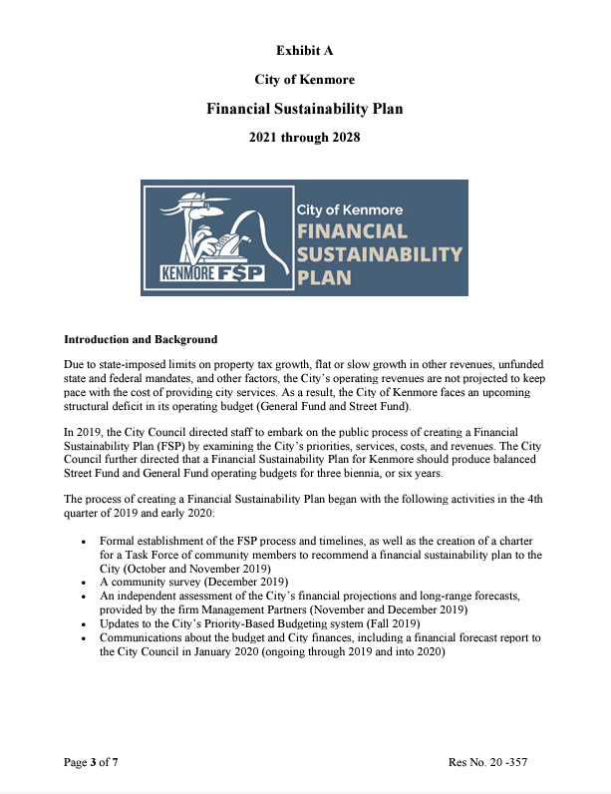
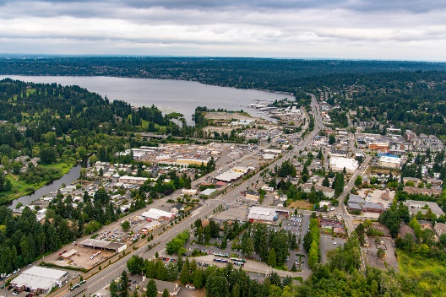
How to know what is best for Kenmore?
City finance education
City staff input
Departments’ suggestions
Synthesis
Resident strategic suggestions (Town Hall)
2024 FSP recommendations and report
Resident input
Detailed budget suggestions through BalancingAct

Slide 7
City budget allocation (biennium)
Street $3.8 million
Strat opportunities
ARPA
Everything except the topics covered by other funds
Strat reserve
Public Art
Transport benef
Real Estate (REET)
…
Park impact fee
General fund $32.7 million
Special funds (illustrative)
Only the general and street funds are in scope for FSP
Total $87.3 million

Slide 8
Top general fund line items (biennium)
Expenditures
Revenues
Public safety
$10 million (32%)
Property taxes
$11.5 million (37%)
Public works, parks & facilities
$3.7 million (12%)
Sales taxes
$8.9 million (28%)
City Manager office
$3.6 million (12%)
Utilities taxes (elec/gas/cable…)
$3.9 million (12%)
Other expenditures
$14.0 million (44%)
Other revenues
$7.0 million (23%)
$31.3 million
$31.3 million

Slide 9
Focus on expenditures
Review of the 3 levels of service
8%
36%
CORE
BASIC
ENHANCED
Align with Katrina as she’s covering the slide that we could tweak core and basic, just make it clear that it has maybe more impacts
Services essential to public order and life safety
Foundational services; “what a city does”
Raises our quality of life & discretionary
56%
Examples
Road maintenance
Police
City governance
Courts
Emergency management
…
Examples
Park maintenance
Streetscape maintenance
Employee training, IT
Front desk reception
…
Examples
Rec programs
Events
Human services
Affordable housing
State & Federal lobbying
The Hangar …
Notes:
Hand over to Katrina

Slide 10
Focus on expenditures
Headcount comparison with neighboring cities
Cities full time equivalents per capita (per thousand residents)
5.6
3.70
2.35
2.37
Bothell
Kenmore
Lake Forest Park
Mercer Island
3.38
Averages
4.61
3.37
3.66
1.43
Mill Creek
Mountlake Terrace
Shoreline
Woodinville
* WA State Office of Financial Management

Slide 11
Focus on expenditures
Contract city limitations
Contract
In-house
Public safety annual fee
Internal investigation
Community programs
Criminal investigation
Internal investigation
Community programs
Criminal investigation
Special Operations
Marine unit
Patrol operations
Admin
Training
Finance
HR
Special Operations
Patrol operations
IT
Ethics
Procurement
Insurance
…
Support services
Need based public safety service
Contracting forces Kenmore to pay a fixed fee but outsources all supporting services and risk
An internal police force could be much more expensive due to our limited needs

Slide 12
Focus on expenditures
Examples of options and avenues considered so far
Shift project management costs to grant funded projects only
Street lights ➔ LED
Reduce number of public events
Bring landscape maintenance in-house
Reevaluate city insurance provider

Slide 13
Focus on revenues
City vs. State & County taxes
Despite property taxes accounting for most of Kenmore’s revenues, that is only a small and proportionally increasingly smaller fraction of our total homeowner property taxes
https://dor.wa.gov/about/statistics-reports/property-tax-statistics/property-tax-statistics-2023 - Property Taxes by Fund across WA, According to Tax Year Due

Slide 14
Focus on revenues
Legal caps on tax increases
Kenmore
Kenmore
Kenmore
+1%
6%
4%
Property tax
Natural gas
Electric
1% levy limit: if a city levies their highest lawful l levy, it can only increase it by 1% the next year*
6% unless voters approve a higher rate
6% unless voters approve a higher rate
Kenmore
Kenmore
Kenmore
6%
6%
$40
Telecom
Cable
Car tabs
6% unless voters approve a higher rate
May not be “unduly discriminatory”
$50, must wait for 24 months or Feb 2025 before next increase
* + any tax revenues generated by new construction, improvements to property, state assessed utility value increases, and wind turbines, solar, biomass, and geothermal facilities added to the tax rolls in the past year
Current Kenmore rate – “legal max” attained
Current Kenmore rate – “legal max” not attained

Slide 15
Focus on revenues
Examples of options and avenues considered so far
Transportation Sales Tax (0.0% - 0.2%)
Electric utility tax (4%➔6%)
Car tab increase (>Feb 2025)
Public Safety property tax levy lid lift
KAPE expansion (photo enforcement)

Slide 16
Guiding principles*
Pointing the task force in the right direction
Identify the benefits of city services to non-residents and consider recommendations for revenue increases that fairly share the cost burden with them.
Pursue a balanced approach that complies with changes in State regulations, and that utilizes the results of the Service Level Budgeting.
Preserve ongoing funding for necessary levels of service, maintenance and upgrades when recommending budget reductions. Keep realistic levels of service in mind when recommending revenue increases.
Include all levels of the city when looking at challenges and opportunities: neighborhoods, businesses, communities, schools, city operations and governance
Seek efficient, effective solutions with the greatest importance and financial impact, including those with high potential for future cost savings and revenue increases.
Use the Equity Framework Tool, striving to minimize disproportionate impacts on residents with fewer resources where possible
* Full wording of guiding principles available on the city’s FSP webpage
Notes:
Hand over to Holly

Slide 17
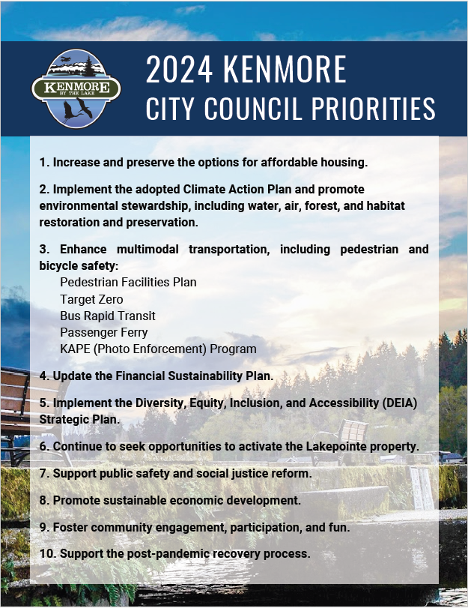
City priorities
Aligning with city council’s vision for Kenmore
Increase and preserve the options for affordable housing.
Implement the adopted Climate Action Plan and promote environmental stewardship, including water, air, forest, and habitat restoration and preservation.
Enhance multimodal transportation, including pedestrian and bicycle safety:
Pedestrian Facilities Plan
Target Zero
Bus Rapid Transit
Passenger Ferry
KAPE (Photo Enforcement) Program
Update the Financial Sustainability Plan.
Implement the Diversity, Equity, Inclusion, and Accessibility (DEIA) Strategic Plan.
Continue to seek opportunities to activate the Lakepointe property.
Support public safety and social justice reform.
Promote sustainable economic development.
Foster community engagement, participation, and fun
Support the post-pandemic recovery process.

Slide 18
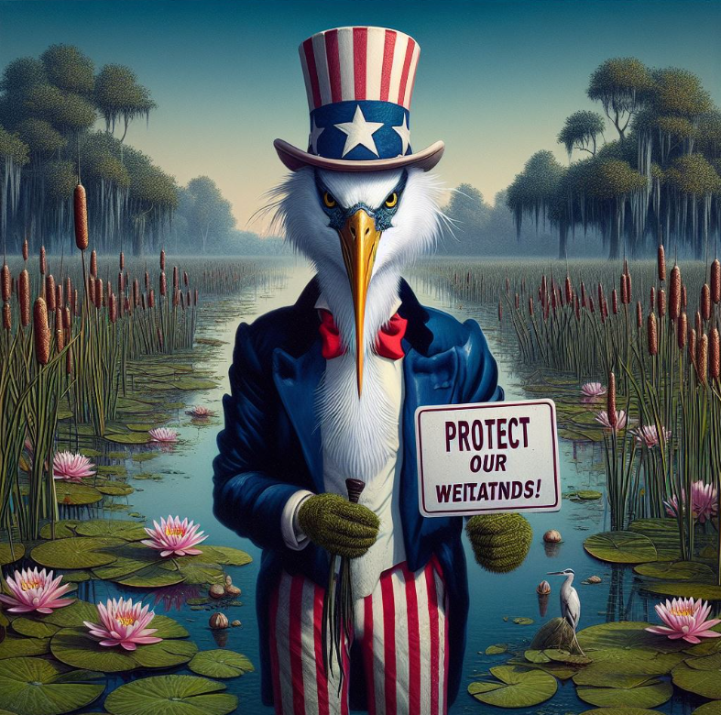
Town hall roundtable
We now need to know what YOU want for Kenmore and what we need to change to balance our finances
At each table, review the different categories and align on what we should drop and add for each
This vision will help us refine our recommendations and the Balancing Act options further!
FSP members will be at each table but please remember they are facilitators, not “experts”
WE WANT YOU!

Slide 19
Town hall roundtable
Departments
Drop
Add
Streets & Traffic Safety
Parks & city buildings
Recreation and city events
Public Safety (police, justice services…)
Sustainability & environment
Administration & community engagement
City planning & permitting
Other…
Additional revenues

Slide 20
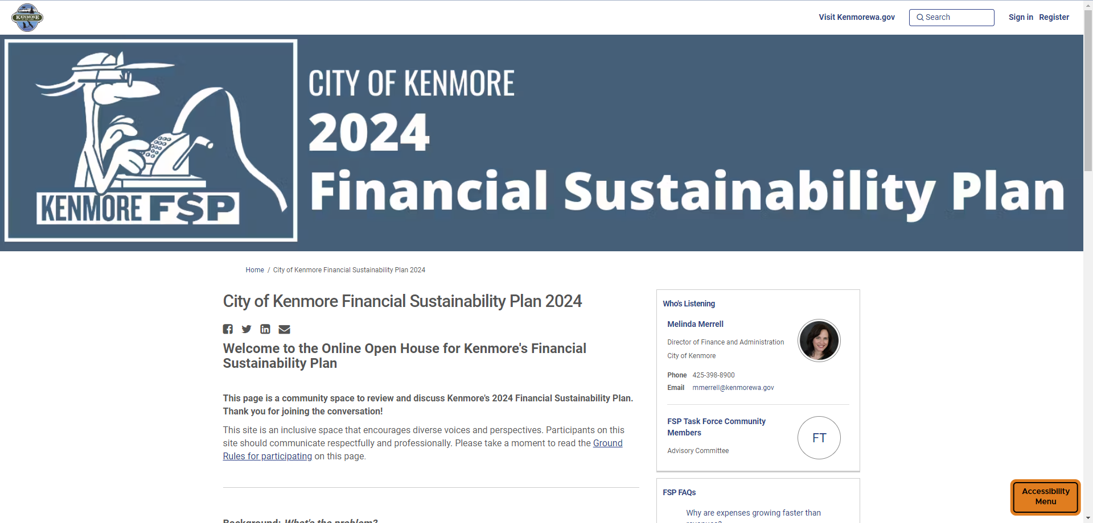
Thank you so much and see you online!
WWW . SPEAKUPKENMORE . COM

Slide 21
Appendix

Slide 22
FSP process to date
December
January
February
March
April
Learning
Recommending
Jan 3
Jan 17
Feb 7
Feb 21
Mar 6
Mar 14
Mar 20
Apr 3
Apr 10/17
Apr 19
May 1
City council
Application, interviews and group formation
Kick-off
Context
Rules
CAP & HHS
Dept presentations
BalancingAct
Update on forecast
Engagement HQ demo
Ideas from Depts
Town Hall!
Contract City
Budget 101
Dept presentations
Service Level Budget
Financial Sustainability
Fiscal Capacity
Guiding principles
Town Hall prep
FSP deliberation
Task force report and recommendations
Town Hall prep
FSP deliberation
City Manager finalizes recommendation
Submission to council
CAP : Climate Action Plan
HHS: Housing and Human Services
Dept: Department
FSP: Financial Sustainability Plan

Slide 23
General fund breakdown (biennium)
Expenditures
Revenues
32%
12%
12%
37%
28%
13%
11%
7%
6%
6%
5%
4%
4%
3%
4%
3%
2%
9%
2%
1%
1%
1%

